Slide 1
Unit 2: INHERITANCE
Simula
Smalltalk
Java, C#, PHP, Python, C++, etc.
Object-Oriented Programming Concepts:
Object
Class
Inheritance
Polymorphism
Abstraction
Encapsulation
Difference between Object-based and object-oriented programming language

Slide 2
How to create class
Syntax to declare a class:
class <class_name>{
field;
method;
}
Instance variable in Java
Method in Java
new keyword in Java

Slide 3
Example of class
class Student{
int id;
String name;
}
class TestStudent1{
public static void main(String args[]){
Student s1=new Student();
System.out.println(s1.id);
System.out.println(s1.name);
} }

Slide 4
3-Ways to initialize object
There are 3 ways to initialize object in Java.
By reference variable
By method
By constructor

Slide 5
Object and Class Example: Initialization through reference
class Student{
int id;
String name;
}
class TestStudent2{
public static void main(String args[]){
Student s1=new Student();
s1.id=101;
s1.name=“XYZ";
System.out.println(s1.id+" "+s1.name);//printing members with a white space }
}

Slide 6
Object and Class Example: Initialization through method
class Student{
int rollno;
String name;
void insertRecord(int r, String n){
rollno=r;
name=n; }
void displayInformation(){System.out.println(rollno+" "+name);} }

Slide 7
class TestStudent4{
public static void main(String args[]){
Student s1=new Student();
Student s2=new Student();
s1.insertRecord(111,"Karan");
s2.insertRecord(222,"Aryan");
s1.displayInformation();
s2.displayInformation();
} }

Slide 8
Constructor
In Java, a constructor is a block of codes similar to the method. It is called when an instance of the class is created. At the time of calling constructor, memory for the object is allocated in the memory.
It is a special type of method which is used to initialize the object.
Every time an object is created using the new() keyword, at least one constructor is called.
It calls a default constructor if there is no constructor available in the class. In such case, Java compiler provides a default constructor by default.

Slide 9
Rules for creating Java constructor
There are two rules defined for the constructor.
Constructor name must be the same as its class name
A Constructor must have no explicit return type
A Java constructor cannot be abstract, static, final, and synchronized
Teypes of Java constructors
There are two types of constructors in Java:
Default constructor (no-arg constructor)
Parameterized constructor

Slide 10
Example of default constructor
class Bike1{
//creating a default constructor
Bike1()
{
System.out.println("Bike is created");}
//main method
public static void main(String args[]){
//calling a default constructor
Bike1 b=new Bike1();
}
}

Slide 11
Java Parameterized Constructor
//Java Program to demonstrate the use of the parameterized constructor.
class Student4{
int id;
String name;
//creating a parameterized constructor
Student4(int i,String n){
id = i;
name = n;
}
//method to display the values
void display(){System.out.println(id+" "+name);}

Slide 12
public static void main(String args[]){
//creating objects and passing values
Student4 s1 = new Student4(111,"Karan");
Student4 s2 = new Student4(222,"Aryan");
//calling method to display the values of object
s1.display();
s2.display();
}
}

Slide 13
Constructor Overloading in Java
//Java program to overload constructors
class Student5{
int id;
String name;
int age;
//creating two arg constructor
Student5(int i,String n){
id = i;
name = n;
}

Slide 14
Student5(int i,String n,int a){
id = i;
name = n;
age=a; }
void display(){System.out.println(id+" "+name+" "+age);}
public static void main(String args[]){
Student5 s1 = new Student5(111,"Karan");
Student5 s2 = new Student5(222,"Aryan",25);
s1.display();
s2.display();
} }

Slide 15
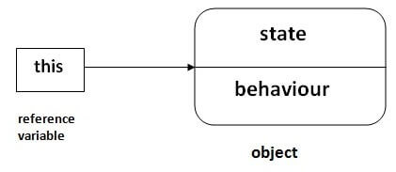
this Keyword
There can be a lot of usage of Java this keyword. In Java, this is a reference variable that refers to the current object.

Slide 16
this: to refer current class instance variable
The this keyword can be used to refer current class instance variable. If there is ambiguity between the instance variables and parameters, this keyword resolves the problem of ambiguity.
For example
class Student{
int rollno;
String name;
float fee;
Student(int rollno,String name,float fee){
rollno=rollno;
name=name;
fee=fee;
}

Slide 17
void display(){System.out.println(rollno+" "+name+" "+fee);}
}
class TestThis1{
public static void main(String args[]){
Student s1=new Student(111,"ankit",5000f);
Student s2=new Student(112,"sumit",6000f);
s1.display();
s2.display();
}}

Slide 18
Example with this keyword
class Student{
int rollno;
String name;
float fee;
Student(int rollno,String name,float fee){
this.rollno=rollno;
this.name=name;
this.fee=fee;
}
void display(){System.out.println(rollno+" "+name+" "+fee);}
}

Slide 19
class TestThis2{
public static void main(String args[]){
Student s1=new Student(111,"ankit",5000f);
Student s2=new Student(112,"sumit",6000f);
s1.display();
s2.display();
}}

Slide 20
Inheritance in Java
Inheritance in Java is a mechanism in which one object acquires all the properties and behaviors of a parent object. It is an important part of OOPs (Object Oriented programming system).
The idea behind inheritance in Java is that you can create new classes that are built upon existing classes. When you inherit from an existing class, you can reuse methods and fields of the parent class. Moreover, you can add new methods and fields in your current class also.
Inheritance represents the IS-A relationship which is also known as a parent-child relationship.

Slide 21
Why use inheritance in java
For Method Overriding (so runtime polymorphism can be achieved).
For Code Reusability.
The syntax of Java Inheritance
class Subclass-name extends Superclass-name
{
//methods and fields
}

Slide 22
Example
class Employee{
float salary=40000;
}
class Programmer extends Employee{
int bonus=10000;
public static void main(String args[]){
Programmer p=new Programmer();
System.out.println("Programmer salary is:"+p.salary);
System.out.println("Bonus of Programmer is:"+p.bonus);
}
}

Slide 23
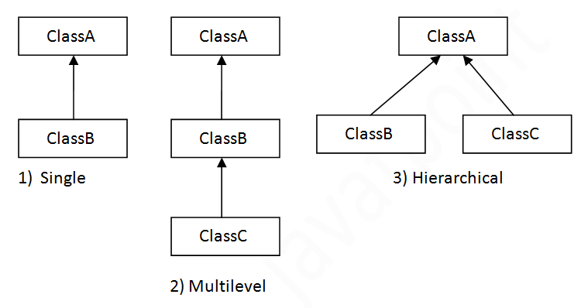
Types of inheritance in java

Slide 24
Single Inheritance
class Animal{
void eat(){System.out.println("eating...");}
}
class Dog extends Animal{
void bark(){System.out.println("barking...");}
}
class TestInheritance{
public static void main(String args[]){
Dog d=new Dog();
d.bark();
d.eat();
}}

Slide 25
Multilevel Inheritance Example
class Animal{
void eat(){System.out.println("eating...");}
}
class Dog extends Animal{
void bark(){System.out.println("barking...");}
}
class BabyDog extends Dog{
void weep(){System.out.println("weeping...");}
}
class TestInheritance2{
public static void main(String args[]){
BabyDog d=new BabyDog();
d.weep();
d.bark();
d.eat();
}}

Slide 26
Hierarchical Inheritance Example
class Animal{
void eat(){System.out.println("eating...");}
}
class Dog extends Animal{
void bark(){System.out.println("barking...");}
}
class Cat extends Animal{
void meow(){System.out.println("meowing...");}
}
class TestInheritance3{
public static void main(String args[]){
Cat c=new Cat();
c.meow();
c.eat();
//c.bark();//C.T.Error
}}

Slide 27
Why multiple inheritance is not supported in java?
To reduce the complexity and simplify the language, multiple inheritance is not supported in java.
Consider a scenario where A, B, and C are three classes. The C class inherits A and B classes. If A and B classes have the same method and you call it from child class object, there will be ambiguity to call the method of A or B class.
Since compile-time errors are better than runtime errors, Java renders compile-time error if you inherit 2 classes. So whether you have same method or different, there will be compile time error.

